Slide 1

About Me: Jeremy Bergmann
About Me
Father of 3 Girls – 12, 9, 3
Lifetime Learner/Teacher
BI&A Pro - Tech Entrepreneur
Hobbies/Passions
Analysis & Statistics
Business News, Crypto
Sports – Playing, Analysis, Coaching
Reading, Exercise, Teaching

Slide 2

Background & Expertise
Professional Mission Statement
To provide Business Intelligence & Analytics (BI&A) Education and Professional Services that enables business to create value by using Data.
Experience
13+ Years Business Intelligence & Analytics, Data Analysis, Data Mining, Market Research
BI Technologies, Data Visualization, BI Platform Design, Implementation & Self-Service
Education
BS Computer Science & MS Statistics University of Nebraska-Lincoln
MBA/BI&A
Creighton University
JB Analytics Consulting
Training: BI&A & Cloud Technologies, Data Visualization, Crypto & Blockchain, Data Science
Services: BI&A Strategy, Machine Learning/AI, Natural Language Processing, Platform Design & Architecture

Slide 3
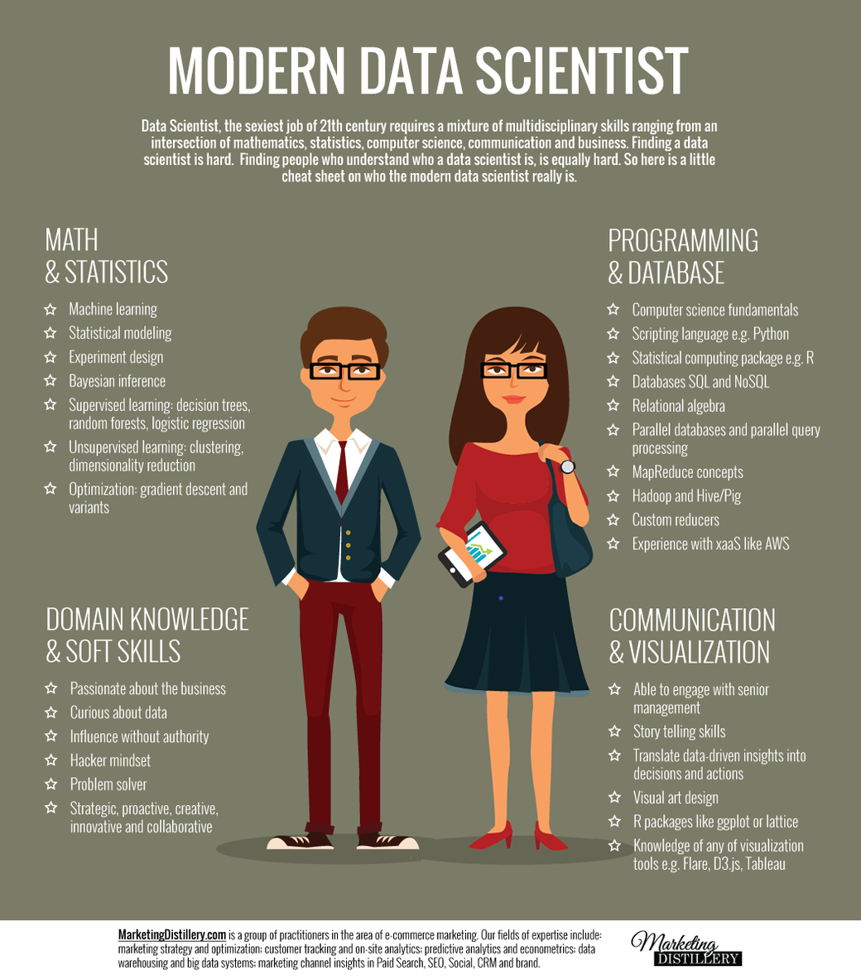
Data Science Philosophy
Combines Tech, Science, Psychology & Business
Data Science vs. Data Engineering
Diversity-of-thought & Soft Skills are keys to success!

